Slide 1
PyTurboGrid
Testing on STAC Turbine

Slide 2
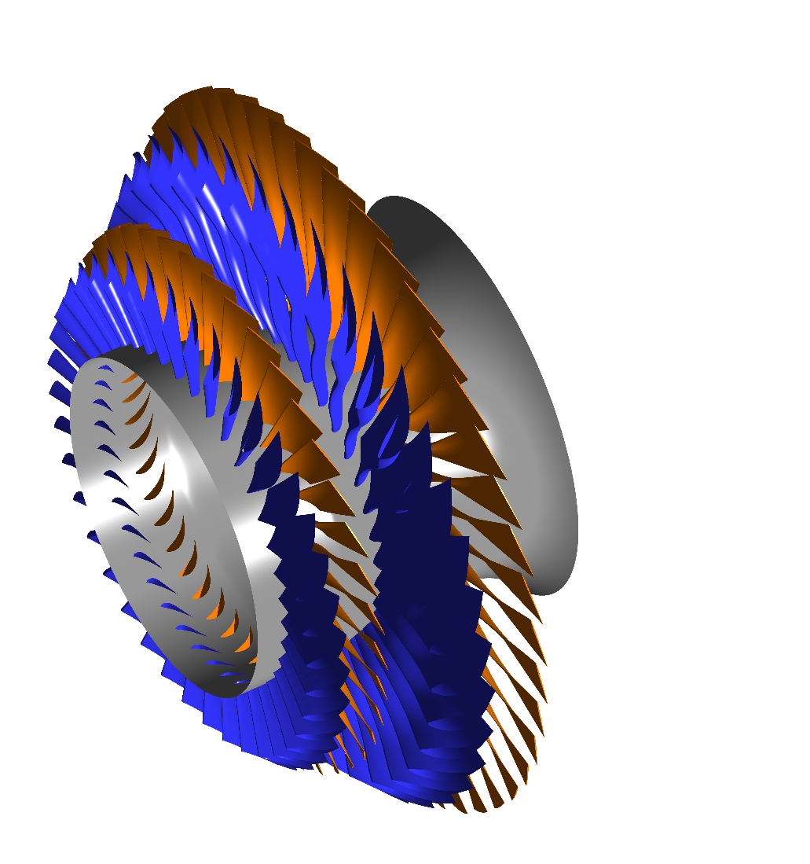
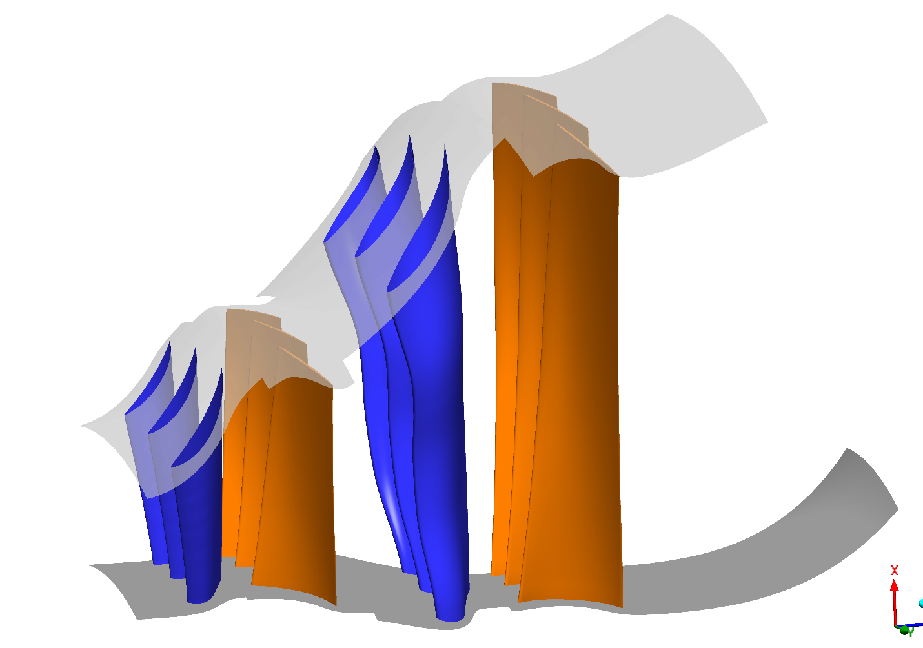
STAC Turbine
Turbine consisting of 4 blade rows
Curve files and inf files available for each row
Ndf files not available
Attempt to use multi blade option in PyTurboGrid for meshing
S1 R1 S0 R0

Slide 3
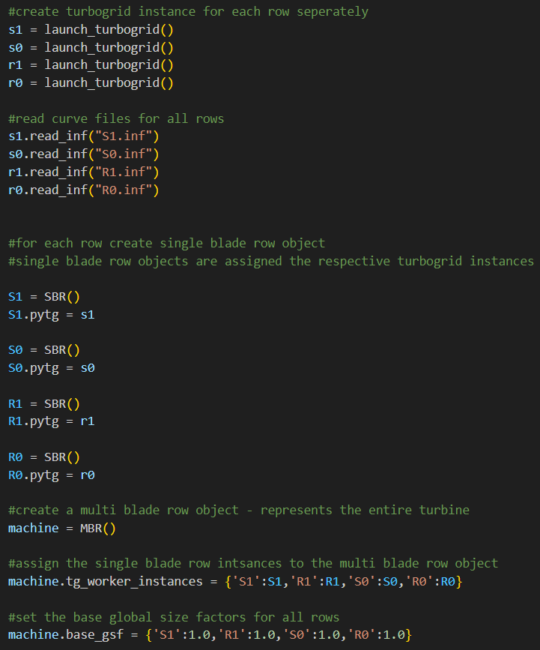
Workaround
For multi blade rows only possible to initialize using a ndf file
No option for curve files / inf files
Possible to initialize single rows as turbogrid instance with an inf file
Using these instances for multi blade rows
Workaround using multi_blade_row:
Create single blade row instances and assign respective turbogrid instances
Assign dictionary of single blade row objects to multi blade row object
If doing so necessary to quit all turbogrid instances separately and clear tg_worker_instances dictionary

Slide 4
Questions / Remarks
Difference Multi_blade_row / Multi_blade_row_batch --> when to use which?
set_number_of_blade_sets() → required for all rows although information is given in the inf file
set_machine_target_node_count
Appears to set node count for every row not entire turbine?
Set_obj_param used to set inlet / outlet shroud and hub points
Not working to use “Requested ART = X X X” and set via the A value
Alternatively set the parametric locations

Slide 5
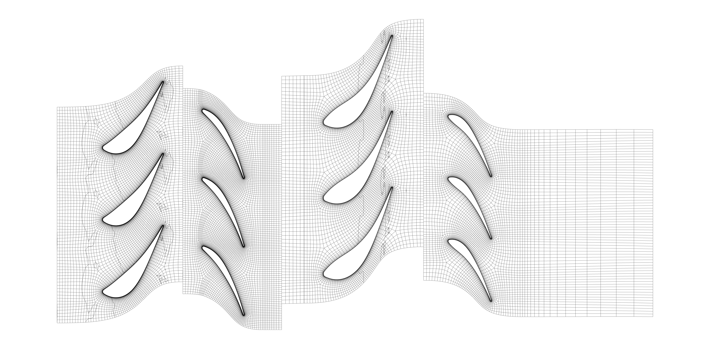
Global Size Factor 0.9 at Span 0.5
S1: 206290 elements
R1: 372998 elements
S0: 171570 elements
R0: 249676 elements
Total: 1000534 elements
Notes:
→ Mesh transitions between rows not

Slide 6
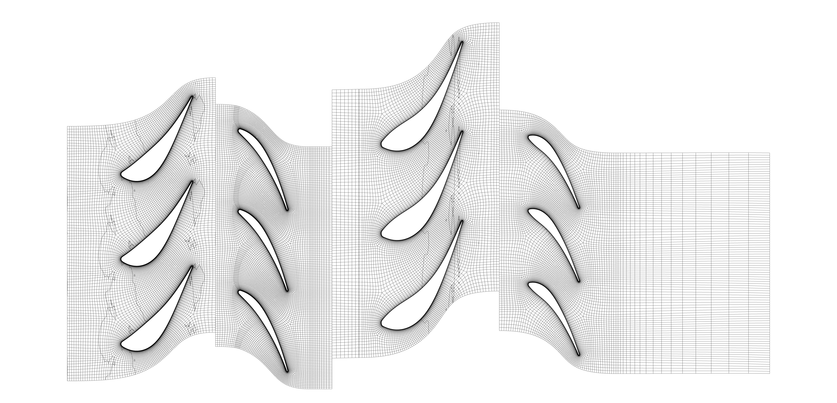
Global Size Factor 1.2 at Span 0.5
S1: 368340 elements
R1: 670536 elements
S0: 314510 elements
R0: 456680 elements
Total: 1810066 elements
Notes:
→ Mesh transitions between rows not smooth

Slide 7
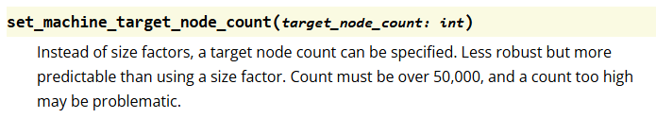
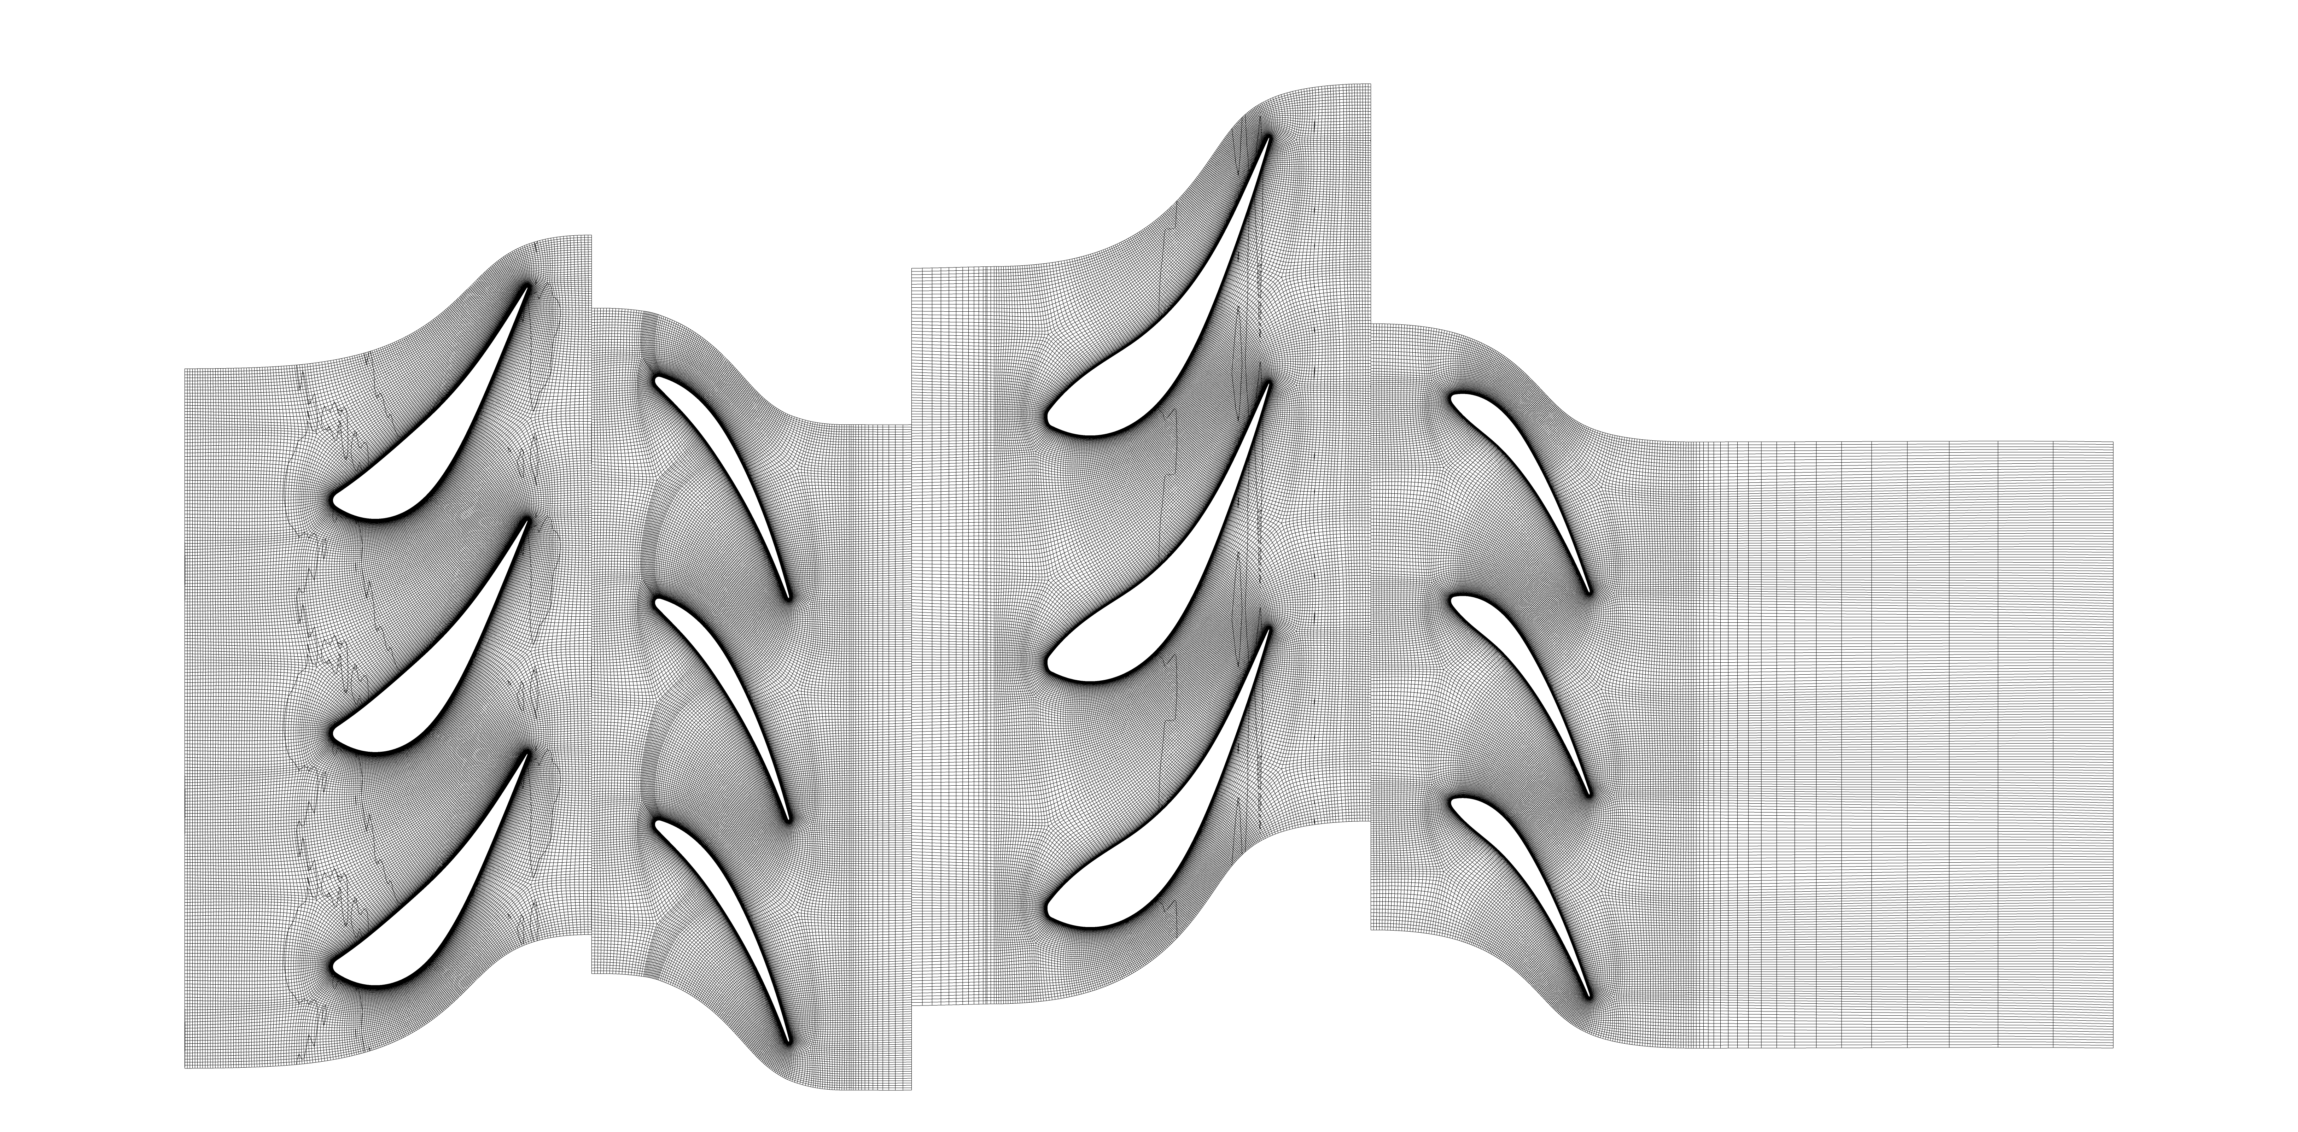
Machine Target Node Count 4M at Span 0.5
S1: 4083730 elements
R1: 4416338 elements
S0: 4113550 elements
R0: 4458076 elements
Total: 17071694 elements

